Slide 1
Winforms: Message Boxes
Getting and Giving Feedback

Slide 2
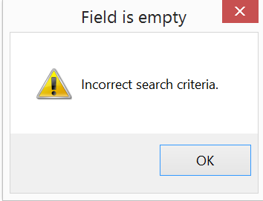
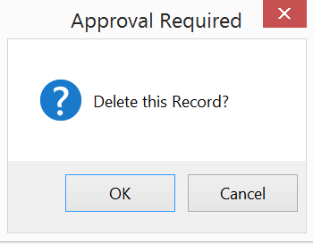
Types of Message Boxes
This message box does not gather user responses. It offers information only, so when the user clicks, OK, the dialog just closes
This message box offers information and gathers the user response (OK or CANCEL). So when we use this box, we typically pair it with an assignment statement to capture the user’s choice.

Slide 3
Customizable Parts of a Message Box: Box that Outputs Information
2. Title
4. Icon
1. Text
3. Type
$msgBox = [System.Windows.Forms.MessageBox]
$msgbox::Show("Incorrect search criteria.", "Field is empty", "OK", "Warning")

Slide 4
Customizable Parts of a Message Box: Box that Gathers a Response
2. Title
1. Text
4. Icon
3. Type
$msgBox = [System.Windows.Forms.MessageBox]
$response = $msgbox::Show ("Delete this Record?",
"Approval Required",
"OKCancel", "Question")

Slide 5
Valid Button Types
OK
OKCancel
AbortRetryIgnore
YesNoCancel
YesNo
RetryCancel

Slide 6




Valid Icon Types
None
Hand
Error
Stop
Question
Exclamation
Warning
Asterisk
Information

